Slide 1
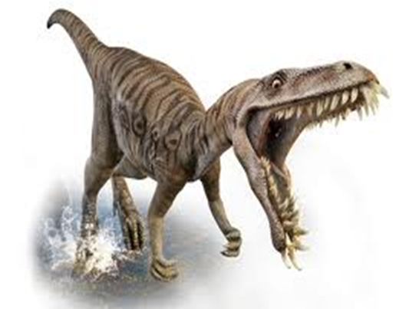
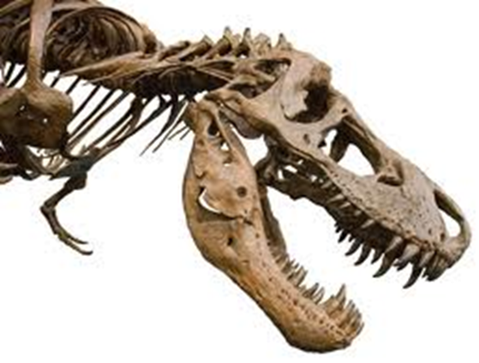
Early dinosaur discoveries

Slide 2
Part One
A Journal
30/8/11 Checking at home sources for information about first palaeontologists and fossil collectors. Finished part three -Now Persuade Us, then started on part one- Research & Reflection.
3/9/11 Started looking into part two-Knowledge & Understanding. Finished part one and finished part two.
5/9/11 Looked at, read, thought about, adjusted and then completely finished my “Science Changing the World” project.

Slide 3
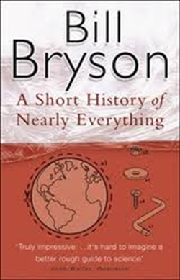
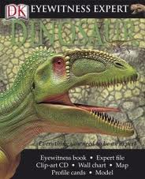
My research information has been gathered from two books
“A Short History of Nearly Everything.
By Bill Bryson, Published by “Black Swan” in 2003
“Eyewitness Dinosaur Expert Files”
A hands-on guide to dinosaur hunting, as explained by professionals in the field.
Published by “DK Publishing, Inc.” in 2007

Slide 4
RESEARCH JOURNAL ENTRIES
Reflection No 1
I have been asked to write about a Scientist, Discovery or Invention. I chose to write about the first discovery of dinosaurs.
I don’t understand this question.
I need to read about the discovery of dinosaur bones and the realization of their existence.
I need to find a good book on the subject.
I immediately picked what is a very good book.

Slide 5
Reflection No 2
What I found surprising was that “A Short History of Nearly Everything” written by Bill Bryson was so interesting.
So what does this mean for my project? In this book I found so much information I felt a bit sad that I didn’t do more and the book “A Short History of Nearly Everything was so full of information I didn’t feel like I needed another book.
Now what? I feel that it is not so hard to do a project. So at Moss Vale High School to do another, I will know how to do this.

Slide 6
Reflection No 3
1. Mostly what l enjoyed about this task we were given was the book I found for my research. (I am a lover of books.)
2. What I found most challenging was part 2. There was so much information but I could not type it all down.
3. I believe I have really worked hard on this and tried to do the best to my understanding of the task and my capabilities.
4. I wish I had started earlier than l did. I would have had more time for my planning, research and writing, on what is one of my most favourite subjects!
5. I feel good about the results of my effort, that l have tried and that l did not give up, when l felt so over whelmed with frustration. Many thanks to my parents and my tutor for helping me along the way. It is really appreciated.
Also thank you Moss Vale High School for bringing this opportunity to me and surprisingly I have really enjoyed this task.
Part Two
Research
The significance of realizing the existence of dinosaurs for such a long period caused a lot of questioning previously held ideas. Also, the interest in fossils was a way of learning about the past, because never on this earth will there be dinosaurs again

Slide 7
Q. How did it change the world?
A. Dinosaurs changed the world because in the 1700-1800s scientists believed that the earth was only ten million years old, Charles Darwin calculated that it would take 306,662,400 years for the world to be able to hold life. There was no concrete proof that would hold his claim the world was that old.
In 1787 a man found a huge thigh bone sticking out of a riverbed in New Jersey and he gave it to a scientist, the nation’s leading specialist in anatomy, called Dr Caspar Wistar. Unfortunately, he missed the opportunity to be known as the discoverer of dinosaurs. Dr Wistar did not realize the significance of the find. The thigh bone was stored and was lost. People now knew that the earth was older than ten million years.

Slide 8

Q. Why is it important to me?
A. It is important to me, because it is a big part of the earth’s history and I have always been fascinated by dinosaurs. I love dinosaur movies like: “Lost World” and “Jurassic Park”, TV series and CD-ROM from the BBC “Walking with Dinosaur’s” . Have books like “DK Eyewitness Expert Dinosaur” and “Dinosaur Life Size”. Here is a picture of my favourite dinosaur’s skull (a
Tyrannosaurus Rex)

Slide 9
Q. How has it changed the past/ present/ future?
A. It has changed the present by increasing our knowledge of the past. If no one found dinosaur bones we wouldn’t know about flying reptiles, ocean dwelling reptiles and the T.K. extinction. We wouldn’t know about early insects, early arachnids and the first bony fish. So if we did not discover dinosaurs we would not have discovered those amazing animals that are a big part of earth’s history.

Slide 10
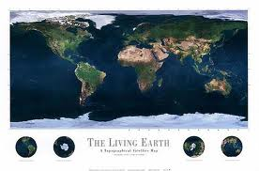
Part three
Dinosaurs is one of the most popular interests of young students in science and discoveries. It usually is their first big interest in the past. One of children’s great curiosities. Science is the best place for curiosity and fittingly the science classes in year 7 should be named after a great curiosity of the students.
Also, the finding of dinosaur bones happened in the late 1800’s which was at the beginning of the inventing and discovery age, which put us into today’s world.

Slide 11
Fact mine
1. Charles Darwin made evolution known to the world
2. Georges Cuvier was the first palaeontologist to recognise that species can come extinct .
3. The bones of a Anchisaurus, found in 1818 were the first dinosaur bones to be examined and saved. These bones became known as dinosaur bones in 1855
4. Richard Owen came up with dinosaurian in 1841 which means “ terrible lizard”
5. Mary Anning from the age of eleven, twelve or thirteen to forty-eight found an ichthyosaurus, count-less fossils, a plesiosaurus and one of the best intact pterodactyl fossil ever found.
Extra stuff
William Buckland
As a boy growing up in Devon. William Buckland used to go on walks with his father where he would collect fossils from the rocks. When he got older he found the bones of a dinosaur. He discovered and named it megalosaurus (“great lizard”)
Mary Anning
Mary Anning found in1811 a Jurassic ichthyosaurus a plesiosaur and a pterodactyl

