Slide 1
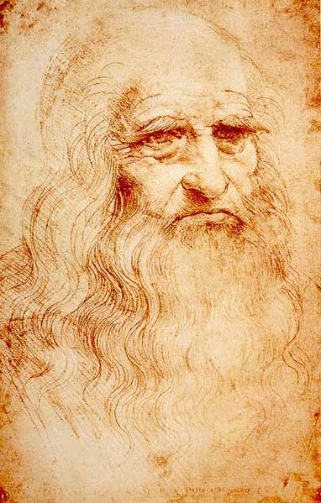
Leonardo da Vinci
Science Life
You may know Leonardo da Vinci as an artist but he was an Inventor and anatomist as well. He didn’t have a formal education and believed that Knowledge could only be learnt with careful observation.

Slide 2
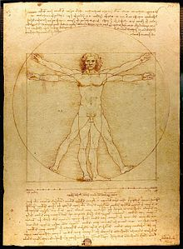
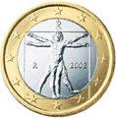
The Vitruvian Man
The Vitruvian Man drawn by Leonardo shows the blend of Art and Science during the Renaissance period when Leonardo lived. It also shows that perfect proportions in architecture relate to the Human body.
The Vitruvian Man is now used as a symbol of the medical profession and medical establishments.
The Italian Euro with the Vitruvian Man

Slide 3
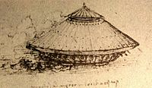
Leonardo’s Tank
This perhaps is Leonardo's most famous project. The turtle-shell-like armour and had weapons at the bottom of it. There were two designs on horse drawn and the human drawn. The horse idea wasn’t used because Leonardo thought that it might panic the horses in the confined, enclosed space.

Slide 4
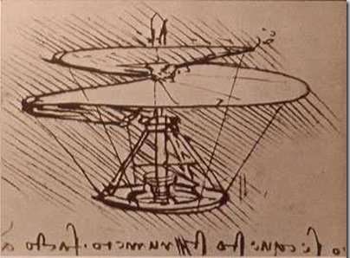
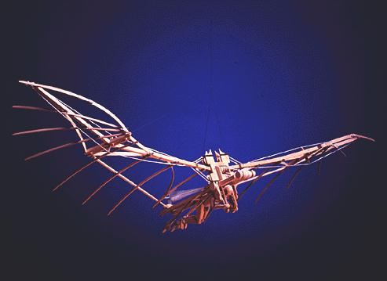
Leonardo’s Flying Inventions
Leonardo had an obsession of flight. He observed how birds and bats flew and he used his observations to invent a flying machine.
He produced many drawings for the first helicopter. The machine was built like a screw. It was nicknamed the ‘Areal Screw’.

Slide 5
Leonardo’s Impact
Leonardo’s impact is important because of his thorough observation in anatomy and impressive idea for inventions such as: the Ornithopter, Bat wings, Tank, vehicle and crossbows. To support my belief that Leonardo impact and influence is current and relevant I have found the following quotes and information.
“da Vinci left behind a legacy that has lasted for centuries and will continue to influence thinkers as well as artists for centuries”(Leonardo da Vinci Biographies of the Renaissance man by Krysta Cardinale-Encyclomedia).
One of Leonardo’s designs for flight, a glider was recreated a few years ago to the specification of his drawings. The test was successful and flew for a longer distance and higher altitude than the historic Wright brothers pilot flight. ( Leonardo da Vinci. Biography)
Leonardo’s tank was tested semi successfully in recent times. Once Leonardo's gears were reversed as he had drawn them backwards the tank worked just as Leonardo described.(Leonardo da Vinci. Biography)

Slide 6
Da Vinci's study of skeletal and muscle tissue, brain anatomy and digestive and reproductive systems advanced human anatomical understanding to a new level.(Answers Yahoo.com)
Leonardo developed ideas that were in some cases the seeds of inventions perfected centuries later such as the airplane, military tank and the parachute.( Wiki answers).
Bibliography
Lives of the Artist, Leonardo da Vinci by A. Mason
Wikipedia
Boston Museum of Science
Encyclomedia
Leonardo da Vinci. Biography
Answers Yahoo.com
Wiki answers

